Slide 1
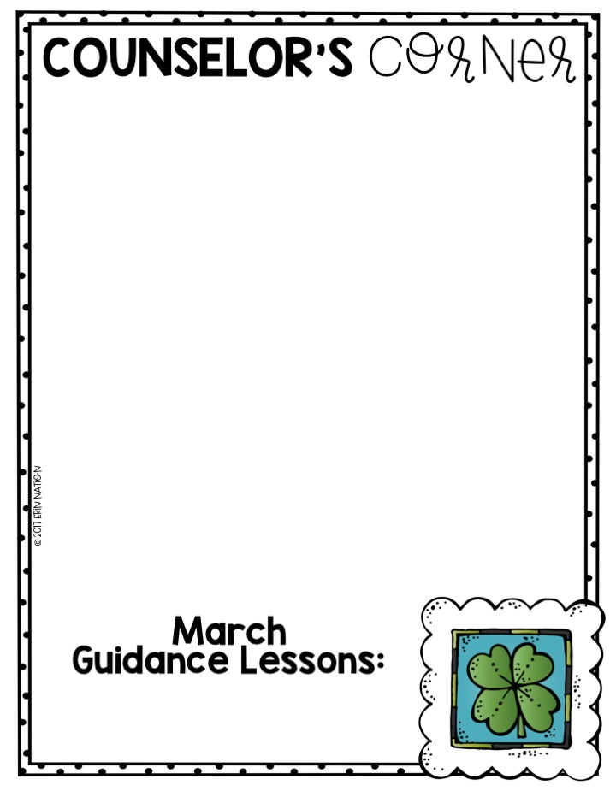
“with the BEST intentions for the children”
2nd grade Core Curriculum Lessons
Self-Regulation
Lesson #1 – Emotions (review)
Emotions are FEELINGS
They tell us -
What is happening around us
How we are reacting to what is happening
Lesson # 2 – I can SHARE my Feelings
(Dug out/On the Field) (review)
Notice your body clues
Name the Feeling
State the Feeling
State the Situation
Lesson # 3 – How Big is your PROBLEM? (current)
Gutter ball – no big deal, no need for an adult
1 pin problem – small, affects a few people
2 pin problem – medium, feelings may be hurt/injury, need an adult
3 pin problem – large, make take several days to solve problem, need an adult
4 pin problem – emergency, needs immediate attention
Click on the link below for more information –
https://www.dropbox.com/s/b7rx133q9rw1c4q/Lesson%2013%20-%20Teacher%20Letter%20-%20Counselor%20Keri.pdf?dl=0
k
3rd grade Core Curriculum Lessons
Self-Regulation
Lesson # 1 – Emotion Levels (Review)
Green – I am good to go!
Blue – I’m running slow.
Yellow – I need to take caution.
Red – I need to stop!
Lesson #2 – Appropriate Behaviors (Review)
In Play Action – behavior or choice that fits the situation
Out of bounds action – behavior or choice that doesn’t fit the situation
Test-Taking Tips (current)
(click on link below)
Milestones Test Prep
Next Lesson – Gameshow
Who wants to Ace a million tests?
Please click on my name, Chandra Garrett, to email me or use the virtual counseling document to request specific school counseling services.
Coronavirus Resources
https://drive.google.com/file/d/1x3eApRJDPdVxpOlq1eEU124oIWpfQDK1/view?mc_cid=567c0051db&mc_eid=1ef6d3afb0
https://drive.google.com/drive/folders/1EC379sSZfj4fez3MeNvsQxBeRtLhn_f9
Next Lessons -
2nd grade – Bullying Prevention
3rd grade – Milestones Preparation

